Slide 1


Facility Location

Slide 2
Introduction
The selection of location is one of the most far-reaching top management decisions for the following reasons:
  It involves the long-term investment of large amounts of capital under conditions of considerable uncertainty.
  It determines a rather permanent framework of operating constraints (legal, labor, community, etc.) that may be difficult and costly to change.
  It has significant consequences on the competitive position or viability of an organization by setting a minimum limit on the cost for production and distribution to desired markets. This is especially true for service systems that must be near the customers they serve, e.g. restaurants or movie theatres.

Slide 3
The location problem
The location problem consists of selecting a site for new facilities that will Minimize the production and distribution costs of products and/or services to potential customers.
The final decision is based on the evaluation of both objective and subjective factors for each alternative site.

Slide 4

Objective Factors
Projected level of annual demand
Projected annual operating cost
  Costs for purchase and transportation of RM
  Costs of wages
  Costs for requirements in energy
  Taxes
Costs for purchasing construction site
Annual profit

Slide 5

Subjective Factors
Existing laws
Labor-market
Transportation networks
Supporting infrastructure
Community characteristics
  Population, attitude, tradition
  Financial institutions
  Cultural activities
  Quality of life
  Housing
  Services

Slide 6
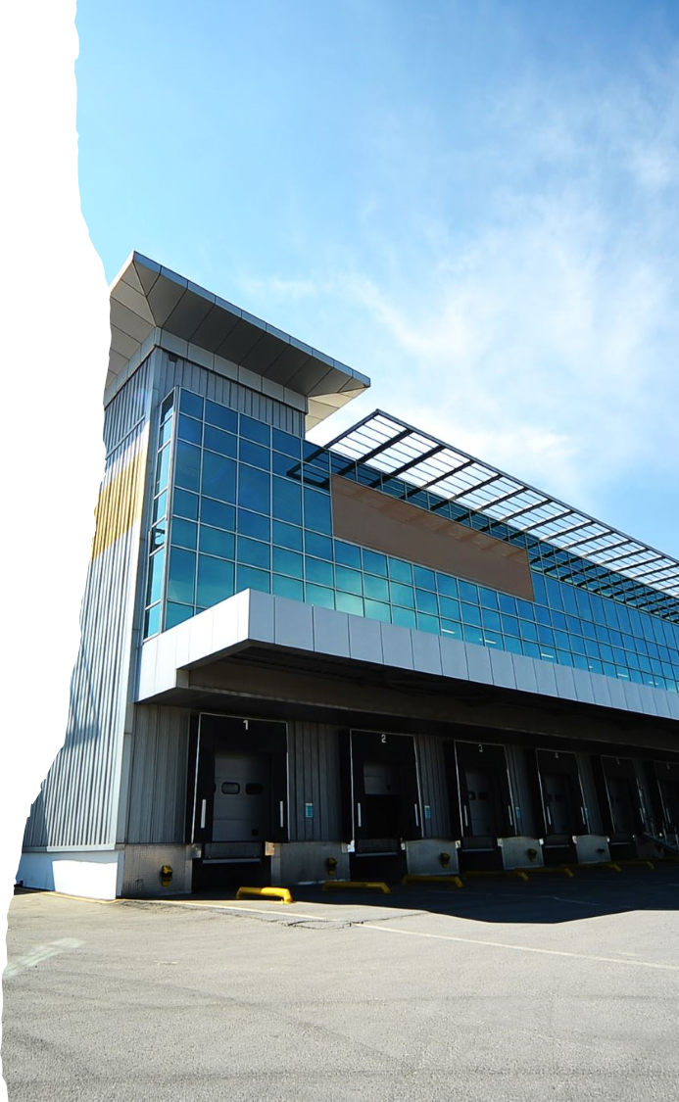
Reasons for considering location problems
The most important reasons for the need to change or expand to a new location are the following:
  Significant changes in the level of demand.
  Significant changes in the geographical distribution of demand.
  Changes in the costs or quality requirements of critical production inputs (labor, raw materials, energy, or other).
  Significant increases in the real estate value of existing or adjacent sites or in their taxation.
  Need to change as a result of fire or flood or for reasons of prestige or improved public relations.

Slide 7
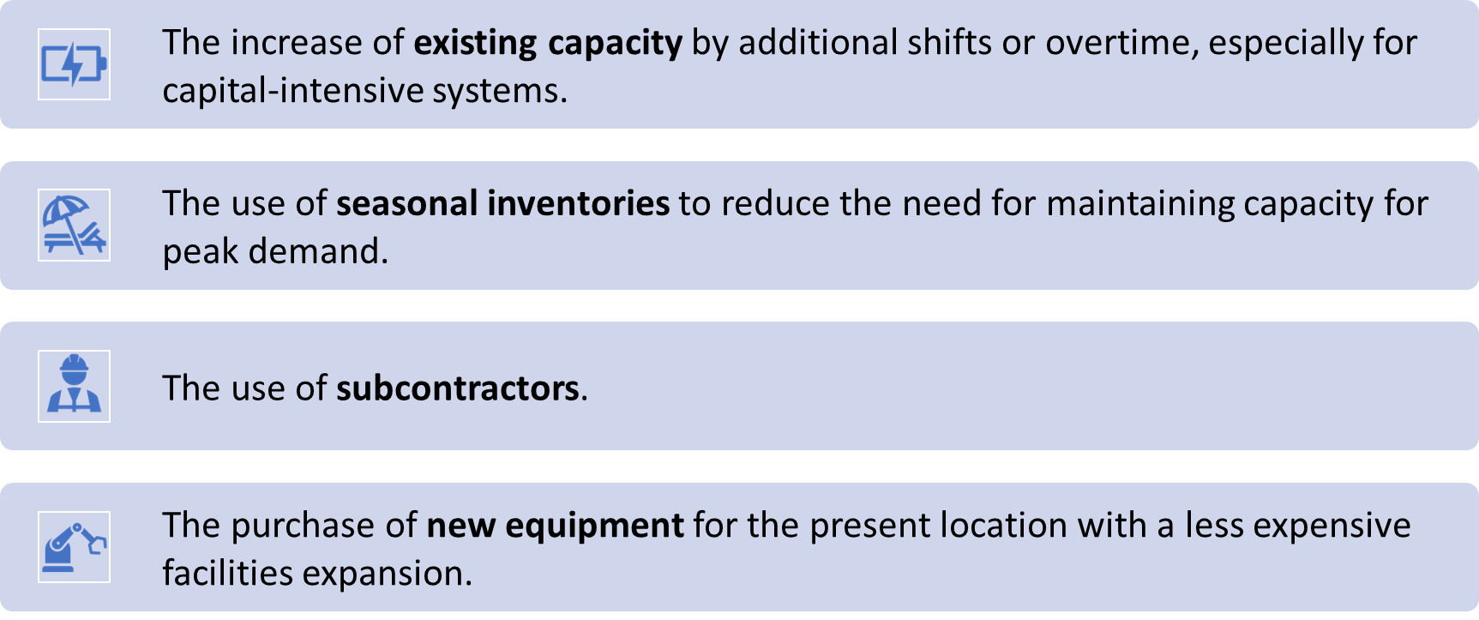
Alternatives to new location

Slide 8
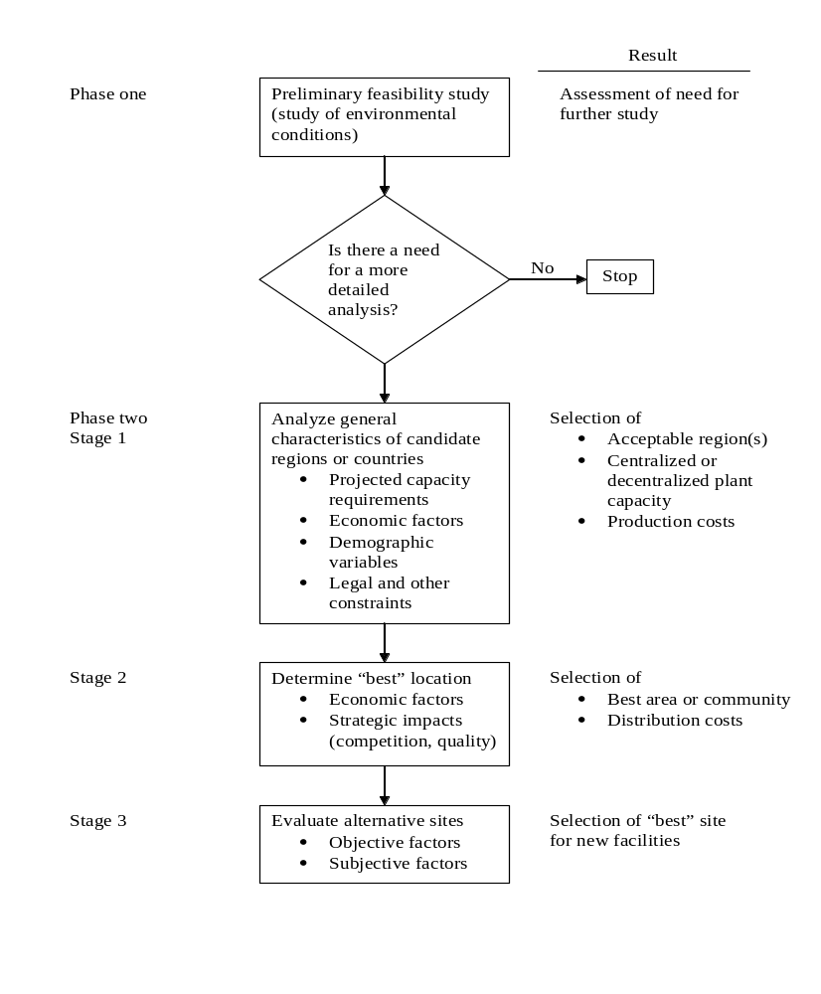
Figure: Procedure for selecting a location for new facilities

Slide 9
The Brown-Gibson approach for site selection
The sequence of steps are followed in this method is:
  Eliminate any site that does not meet certain basic requirements.
  Compute an objective-factor measure of performance OF_{i} for each site.
  Determine key subjective factors and estimate their subjective-factor measure SF_{i} for each site by-
    Deriving a factor rating w_{j} for each subjective factor (j=1, 2, …., n) using a forced-choice pairwise comparison procedure.
    Ranking each site for each subjective factor separately R_{ij.}
    Combining for each site the factor rating and site ranking.

Slide 10
The Brown-Gibson approach for site selection
  Combine for each site the objective-factor measure OF_{i} and subjective-factor measure SF_{i} by assigning weights k and 1-k, to obtain a location performance measure (LPM) -
  LPM = k(OF_{i}) + (1-k)(SF_{i}) 0<k<1
  Select the site with the maximum LPM.

Slide 11
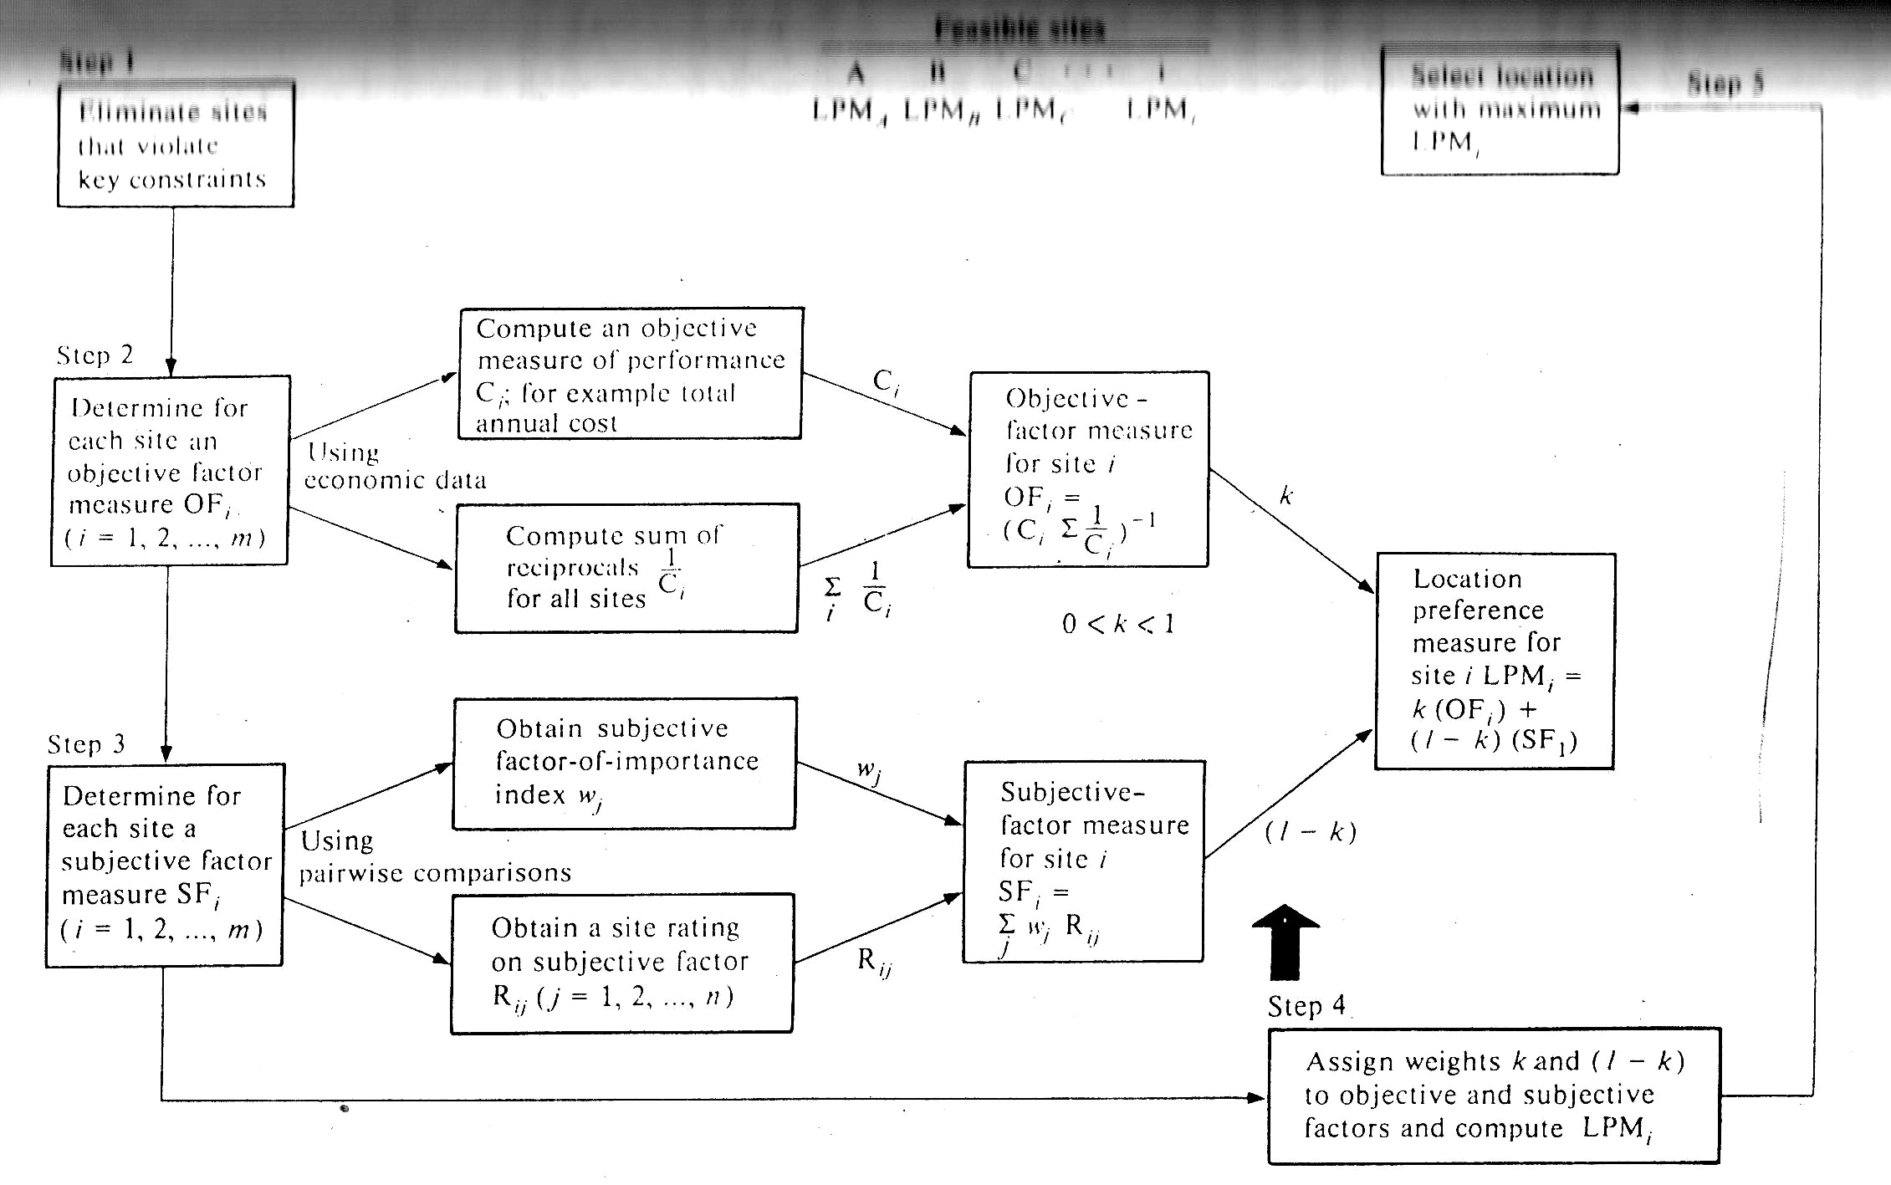
Figure: The Brown-Gibson approach for evaluating locations

Slide 12
A company has three options – A,B,C for relocating. Various annual costs associated with each site are given in table 1. The subjective factors are- Education, Housing and Community. Importance weight for objective factor, k=0.8. The pairwise comparison among subjective factors (Education=Housing, Community>Housing, Community>Education). The pair wise comparison of sites with respect to education, housing and community are ( A>B, C>A, C>B), (A=B, C>B, C>A) and ( A>B, B=C, A>C). Determine the best relocating site.

Slide 13
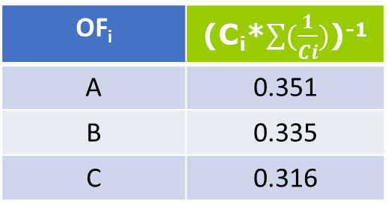
Example
Annual Costs (Millions) |  |  |  |  | Total Ci | Reciprocal 1/Ci
Site i | Labor | Distribution | Taxes | Others
A | 3.62 | 2.08 | 0.25 | 4.00 | 9.95 | 0.1
B | 3.4 | 2.75 | 0.30 | 4.00 | 10.45 | 0.096
C | 3.75 | 2.90 | 0.40 | 4.00 | 11.05 | 0.09

Slide 14
Subjective factor importance rating Wj
Factor j | Pairwise Comparison |  |  | Sum of Preference | Relative importance Wj
 | Education | Housing | Community
Education |  | 1 | 0 | 1 | 0.25
Housing | 1 |  | 0 | 1 | 0.25
Community | 1 | 1 |  | 2 | 0.50
Total |  |  |  | 4 | 1.00
Here,
Education=Housing
Community>Housing
Community>Education

Slide 15
Location site rating Rij
Education (Factor 1)
Site i | Pairwise comparison |  |  | Site ranking Ri1
 | A | B | C
A |  | 1 | 0 | 0.33
B | 0 |  | 0 | 0
C | 1 | 1 |  | 0.67
Total
Here,
A>B
C>A
C>B

Slide 16
Location site rating Rij
Housing (Factor 2)
Site i | Pairwise comparison |  |  | Site ranking Ri1
 | A | B | C
A |  | 1 | 0 | 0.25
B | 1 |  | 0 | 0.25
C | 1 | 1 |  | 0.50
Total
Here,
A=B
C>B
C>A

Slide 17
Location site rating Rij
Community (Factor 3)
Site i | Pairwise comparison |  |  | Site ranking Ri1
 | A | B | C
A |  | 1 | 1 | 0.50
B | 0 |  | 1 | 0.25
C | 0 | 1 |  | 0.25
Total
Here,
A>B
B=C
A>C

Slide 18
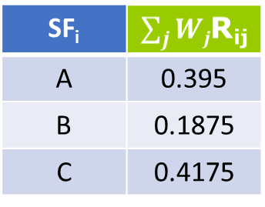
Subjective Factor Measure
Summary of Subjective factor Evaluation
Factor j | Pairwise comparison |  |  | Relative Importance Wj
 | A | B | C
Education | 0.33 | 0 | 0.67 | 0.25
Housing | 0.25 | 0.25 | 0.50 | 0.25
Community | 0.50 | 0.25 | 0.25 | 0.50
Total

Slide 19
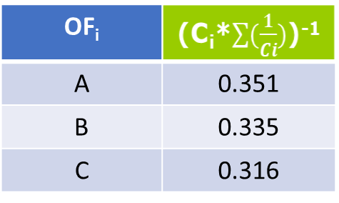
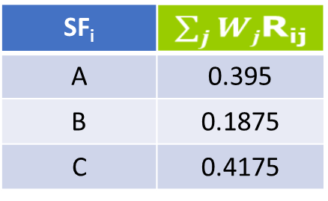
Location Preference Measure
K=0.8
  LPM = k(OF_{i}) + (1-k)(SF_{i}) 0<k<1
LPM
A | 0.3598
B | 0.3055
C | 0.3363

